Slide 1
Market and Technology Research Summary
Team 38: ProtoControl
Kelly Mae Allen, Parker Sexton, Will Wood, Nida Kosedagi, Abisha Fenn
ECE 484 Fall 2023

Slide 2
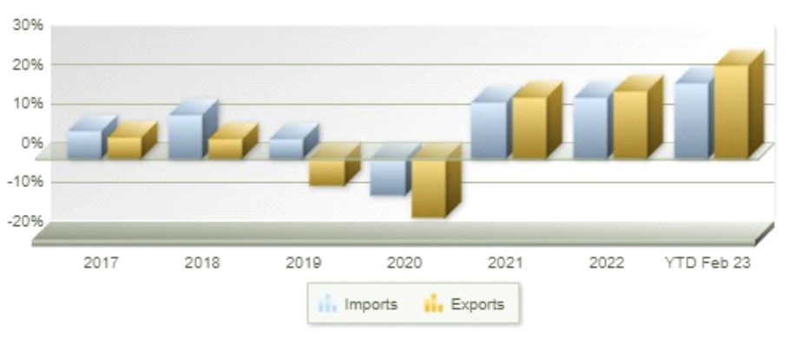
Market summary 1
Target Customers and Market Size
Our customer is entities in the prototyping phase of product development
Start-ups, Hobbyists, Production/Testing Teams of companies (small manufacturing firms, small IC firms)
Market size (focusing on manufacturing companies)
592k Manufacturing firms in the US
US Industrial Control Products Manufacturing Industry has Annual Revenue of $10B*
Mid-sized industrial control manufacturing industry
Change in Dollar Value of US Trade - US International Trade Commission
Brief Need Statements
A way to create UI without a large team
A way to create UI without in depth embedded systems experience
There is a need for an easy, fast, and reliable solution to designing user interfaces
Notes:
*https://www.proquest.com/marketresearch/docview/2813958232/A51194596CF64CAFPQ/4?accountid=12725
* Looking at the sum of 900 companies
https://www.statista.com/outlook/io/manufacturing/worldwide#value-added

Slide 3
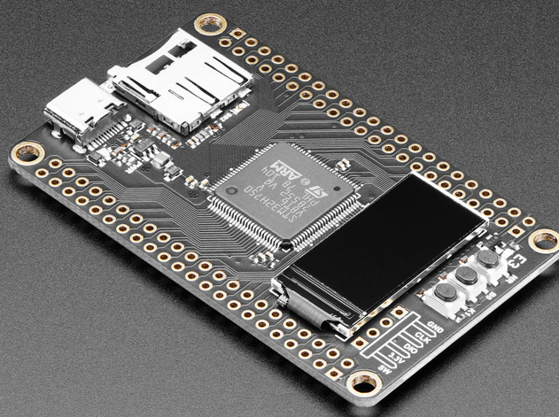
Market summary 2
Competitors and their solutions
Arduino Based User Interface kits
All in one devices
Your value proposition statement
The easiest path to a working user interface
Full customer support
In depth guides
One stop shop for designing software and hardware

Slide 4
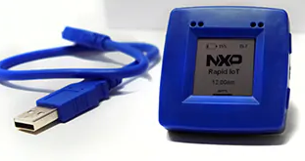
The State of User Interface design
Current technology
Open source microcontrollers
Engineering design firms
Emerging Technologies
IOT design kits
AI Generated User Interface
Applicable Standards:
Programming Standards: PEP-8, ANSI C,
WCAG 2: Web Content Accessibility Standards
I2C Communication Standards

